Slide 1

Raspberry Pi
Lesson: Sensors

Slide 2
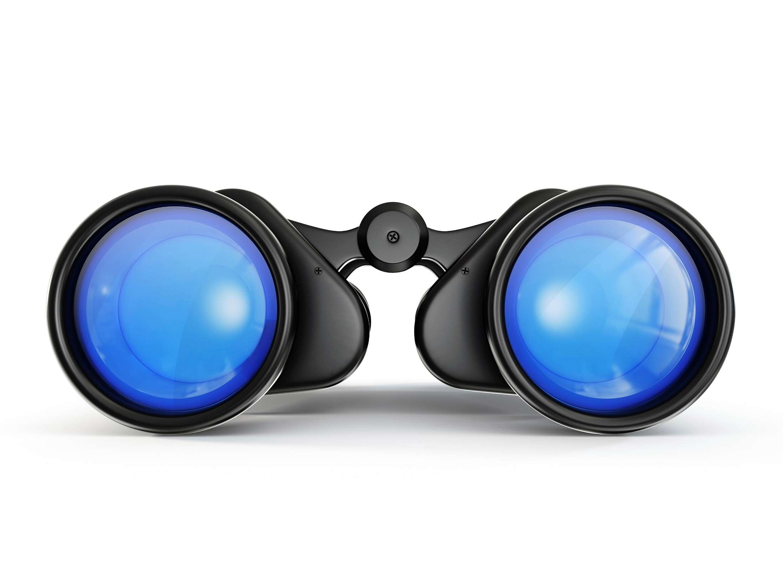
Agenda
What are sensors?
Different types of sensors (examples in python)
Buttons
Sonar
Discussion

Slide 3

What are sensors?
Sensors are any kind of input
Sensors are like our senses
Let’s play the senses game!
Notes:
The point of the game is for participants to get involved, but also to demonstrate how difficult it can be creating a system of interconnected components. This is a good lesson at any level, and worth a bit of a laugh.
The senses game is as follows:
1 Person is nominated as the
‘Brain’ – has to tell the arm what to do (blindfolded – can talk to the arm)
‘Eyes’ – has to tell the brain where things are (can only whisper to the brain)
‘Arm’ – is allowed to touch the object, but can only do what the brain tells it (blindfolded, must not listen to the eyes)
Try to stack some blocks on top of each other

Slide 4
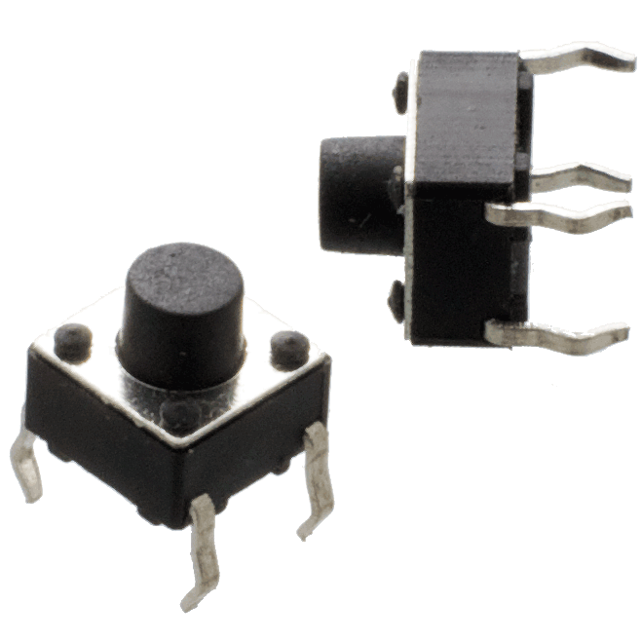
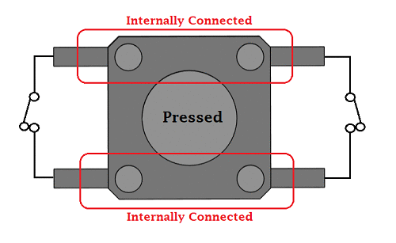
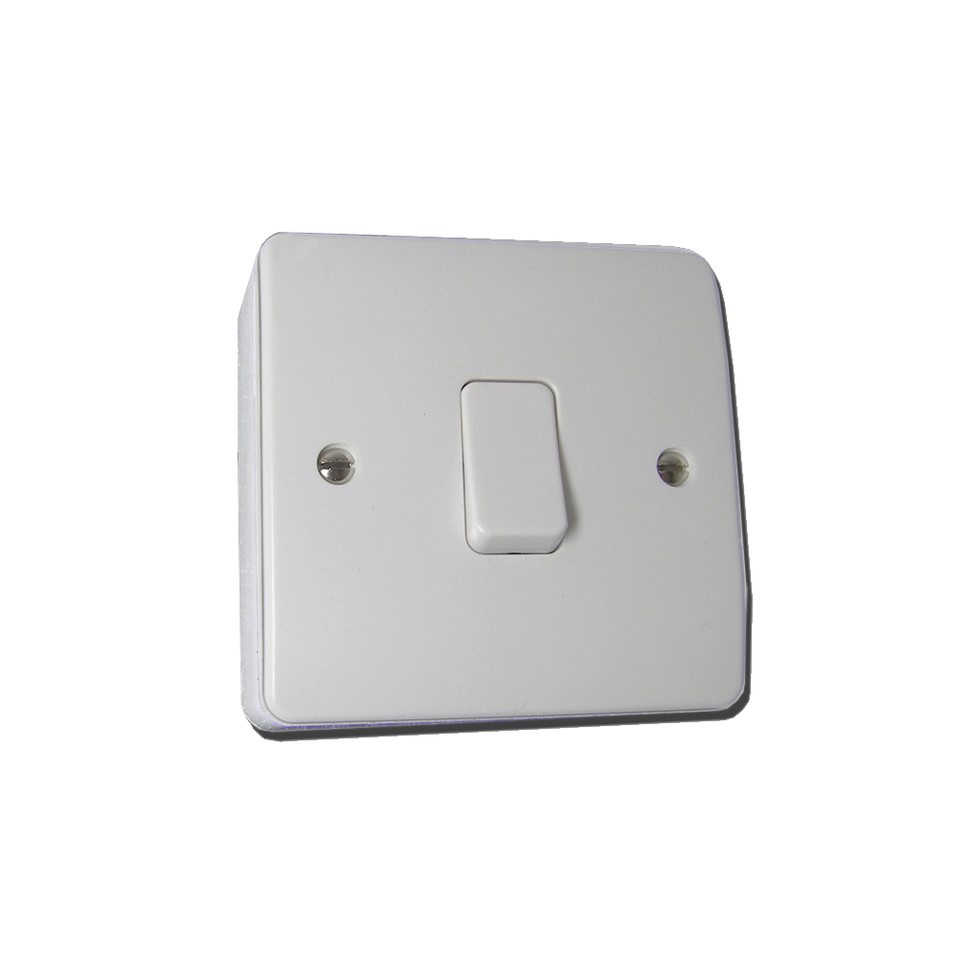
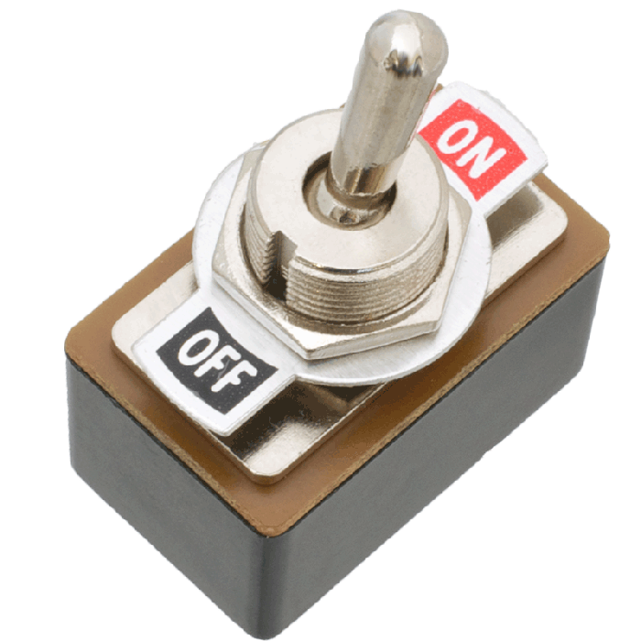
Buttons as sensors
A button is usually either on or off*
A switch is typically just a button that remains where you left it
Notes:
Technically this is not correct. Buttons ’naturally’ are either on or floating. It takes a pull down / up resistor to get the button to achieve the off state. Only explain this if you understand this concept AND your audience does as well.

Slide 5
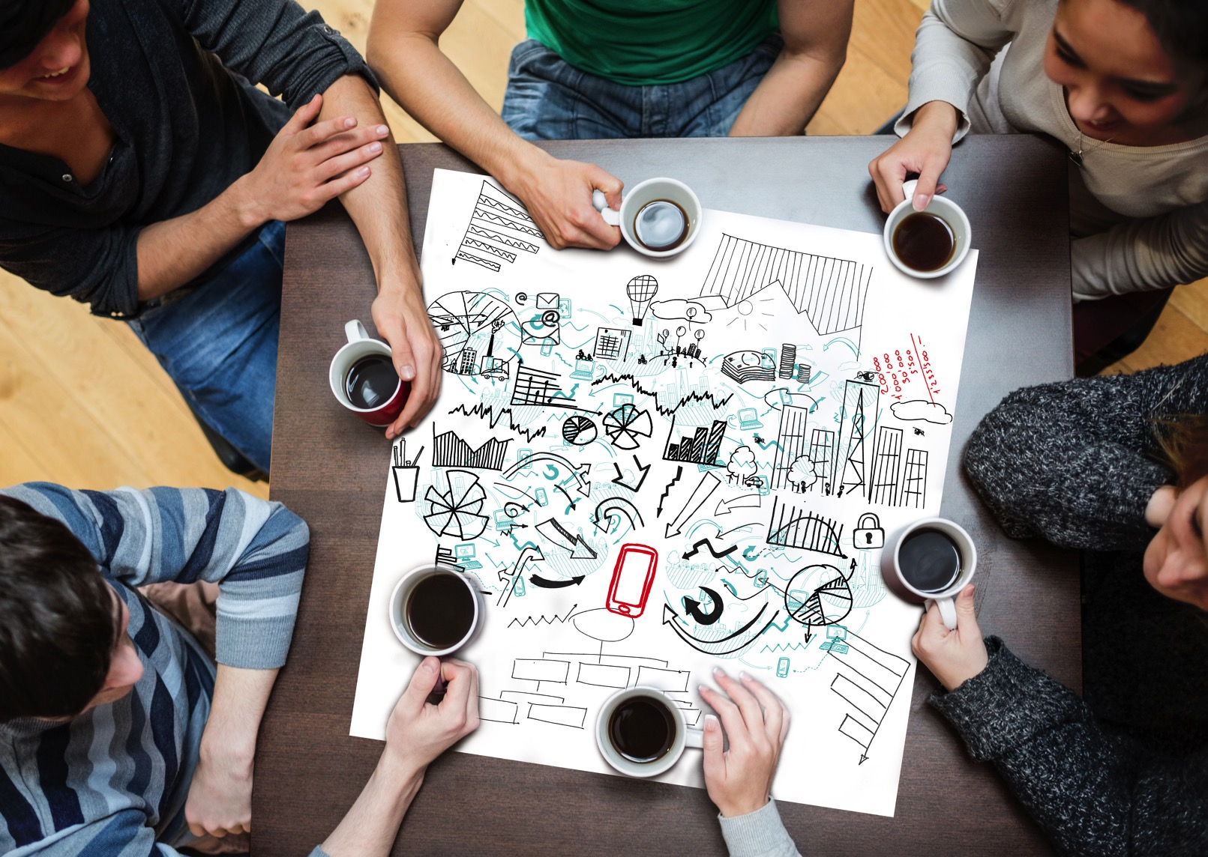
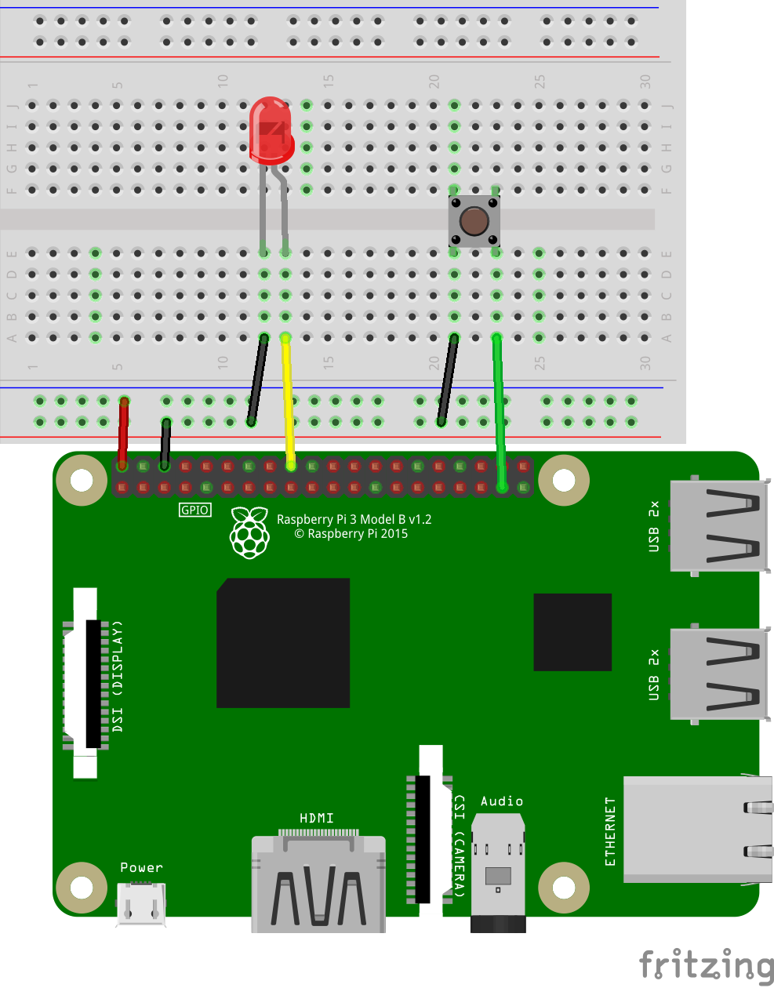
Buttons: example

Slide 6
Buttons: example
import RPi.GPIO as GPIO
import time
GPIO.setmode(GPIO.BCM)
GPIO.setup(26, GPIO.IN, pull_up_down = GPIO.PUD_UP) #Button
GPIO.setup(24, GPIO.OUT) #LED to GPIO24
try:
while True:
button_state = GPIO.input(26)
if button_state == False:
GPIO.output(24, True)
print('Button Pressed...')
time.sleep(0.2)
else:
GPIO.output(24, False)
except:
GPIO.cleanup()

Slide 7
Sonar sensors
Measures distance using the speed of sound

Slide 8
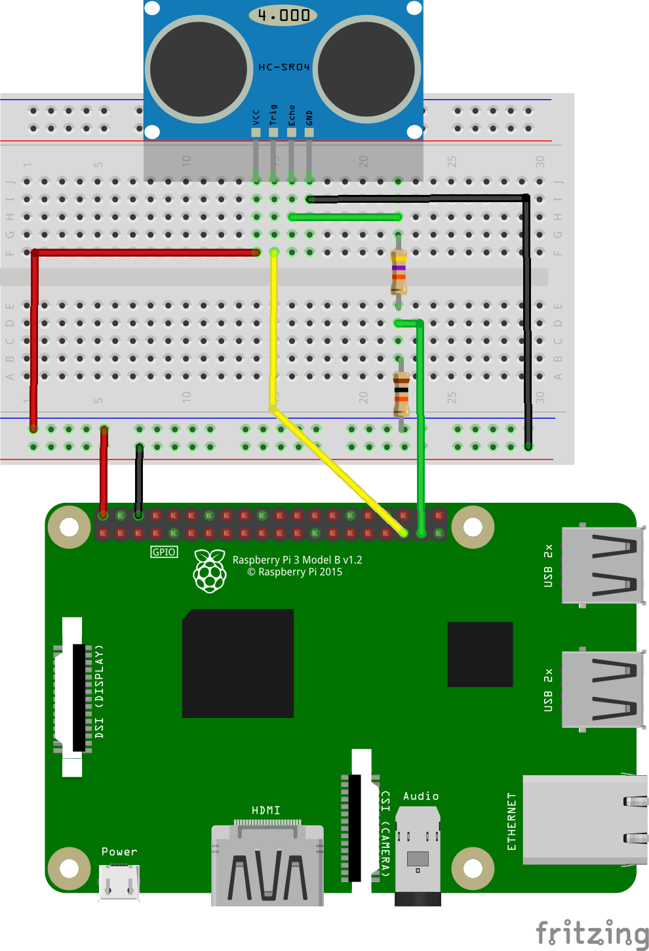
Sonar: example

Slide 9
Sonar: example
#Libraries
import RPi.GPIO as GPIO
import time
#GPIO Mode (BOARD / BCM)
GPIO.setmode(GPIO.BCM)
#set GPIO Pins
GPIO_TRIGGER = 19
GPIO_ECHO = 26
#set GPIO direction (IN / OUT)
GPIO.setup(GPIO_TRIGGER, GPIO.OUT)
GPIO.setup(GPIO_ECHO, GPIO.IN)

Slide 10
Sonar: example
def distance():
# set Trigger to HIGH
GPIO.output(GPIO_TRIGGER, True)
# set Trigger after 0.01ms to LOW
time.sleep(0.00001)
GPIO.output(GPIO_TRIGGER, False)
StartTime = time.time()
StopTime = time.time()
# save StartTime
while GPIO.input(GPIO_ECHO) == 0:
StartTime = time.time()
# save time of arrival
while GPIO.input(GPIO_ECHO) == 1:
StopTime = time.time()
# time difference between start and arrival
TimeElapsed = StopTime - StartTime
# multiply with the sonic speed (34300 cm/s)
# and divide by 2, because there and back
distance = (TimeElapsed * 34300) / 2
return distance

Slide 11
Sonar: example
if __name__ == '__main__':
try:
while True:
dist = distance()
print ("Measured Distance = %.1f cm" % dist)
time.sleep(1)
# Reset by pressing CTRL + C
except KeyboardInterrupt:
print("Measurement stopped by User")
GPIO.cleanup()

Slide 12
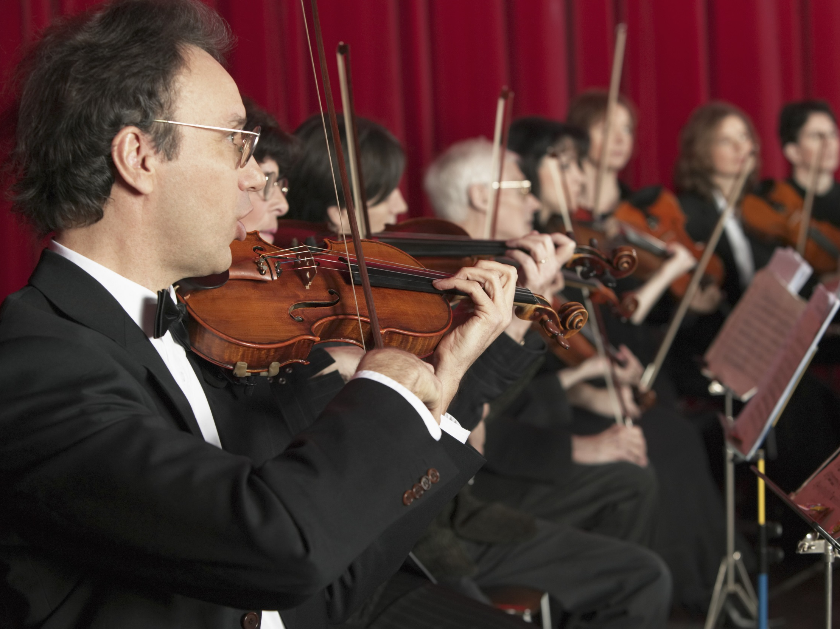
Discussion
What other sensors would you like to make?
Notes:
Examples:
Temperature / humidity
Measure the angle / rotation
Potentiometers (volume controls)
Sound / audo sensors
Gas sensors
Electricity sensors
Touch sensors
NFC sensors (Near Field Communication)

Slide 13

Conclusion
Sensing is the first step! Now you need to do something with the data you collect. Something that acts is called an actuator.
Notes:
Your arms / legs are actuators in the sense that you perform tasks / act on your environment. Your nervous system is a sensor.

